Slide 1
Applied Data Science Portfolio Milestone Presentation
Jeffrey Thomson
jethomso@syr.edu

Slide 2
About Myself
Started the ADS program in April 2020
No prior R or Python programming experience
Proficient with Excel and familiar with VBA
Work as a Financial Analyst for a Hospital

Slide 3
Why I Applied
Over my 18 years of experience, I found:
A lot of data gets collected
It’s often not organized well
Excel is great, but has limitations
Limited data storage capacity
Included analytic packages are can only do so much
Big data analytics is becoming a cornerstone to driving company operations

Slide 4
What I Wanted to Accomplish
Gain proficiency in R-studio and Python
Learn and utilize the analytic power of programming
Bring this knowledge to my current role as a Financial Analyst in the healthcare field.

Slide 5
Discussion Area’s
Collect and Organize Data
IST 652: Scripting for Data Analytics
Project Scope: Analysis of the 2016 Rio de Janeiro Summer Olympic Games
Identify Patterns in Data via Visualization, Statistical Analysis, & Data Mining
IST: 653: Marketing Analytics
Project Scope: Modeling website visitors’ propensity to purchase
Develop Alternative Strategies based on the Data
MBC 651: Business Analytics
Project Scope: Recruiting Advertising Strategy
Develop a Plan of Action to Implement the Business Decisions derived from the Analyses
IST 718 – Big Data Analytics:
Project Scope: Finding Investing Location for a REIT
IST 623 – Information Security:
Project Scope: Analyze the SolarWinds Cyber Attack
Demonstrate Communication Skills regarding Data and its Analysis
IST 652: Scripting for Data Analytics
Project Scope: Analysis of the 2016 Rio de Janeiro Summer Olympic Games
IST 623 – Information Security:
Project Scope: Analyze the SolarWinds Cyber Attack
Synthesize the Ethical Dimensions of Data Science Practice
IST 687: Applied Data Science
Project Scope: Class Discussion on Bias in Machine Learning
Each discussion section will include commentary of the key lessons learned and/or how this will relate to my outcome goals.

Slide 6
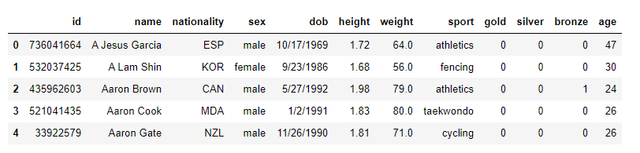
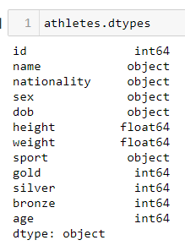
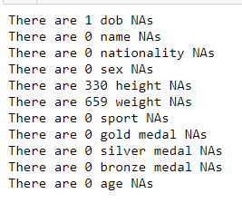
Collect and Organize Data
IST 652: Scripting for Data Analytics
Project Scope: Analysis of the 2016 Rio de Janeiro Summer Olympic Games
Import the “athletes.csv” file from Kaggle
Review string types:
Review for NAs:
For the height and weight columns, replace the NAs with their columns respective mean value

Slide 7
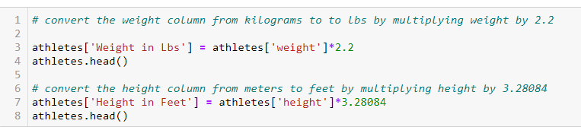
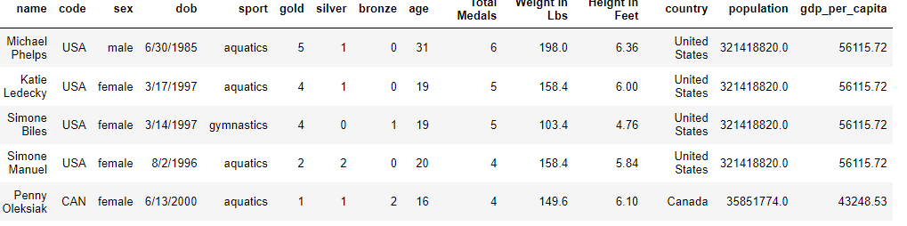
Collect and Organize Data
IST 652: Scripting for Data Analytics
Project Scope: Analysis of the 2016 Rio de Janeiro Summer Olympic Games
Create new Column for total medals won (gold + silver + bronze)
Convert Weight and Height from kilograms to pounds (lbs.)
Import 2nd data set: Countries.csv- Similar analysis was done
Last step was to merge the two files:
Both files contained the country abbreviation code, so I changed column names for them to match.
Used the Left Merge function combine the files
Final results are a 15-column data frame to use for the analytics

Slide 8
Collect and Organize Data
IST 652: Scripting for Data Analytics
Project Scope: Analysis of the 2016 Rio de Janeiro Summer Olympic Games
Reflection and learning outcome:
This can be the most time-consuming part but, is arguably, the most important
Can you trust your data source? Any nuances?
Have a plan before you start organizing and cleaning
Current Work
Many different data sources
Variable names are not consistent across systems
Time of database refreshes

Slide 9
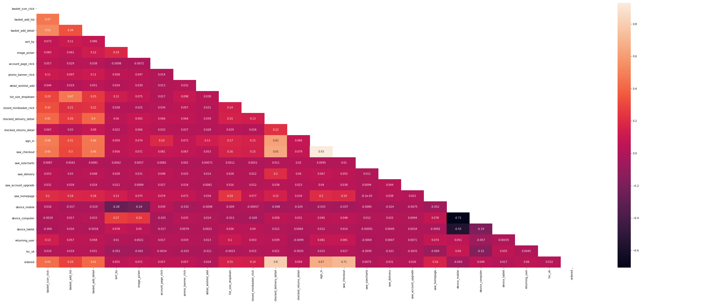
Identify Patterns in Data via Visualization, Statistical Analysis, & Data Mining
IST: 653: Marketing Analytics
Project Scope: Modeling website visitors’ propensity to purchase
Project Goal:
What variables/activity make a customer more likely to place an order?​ (Pattern)
Predict whether a customer will place an order based on past behavior.
Data Set:
One day’s worth of website traffic transactions from 455 thousand customers with 25 variables measuring behavior on the website
All data was binary: 1 = Yes ; 0 = No
Split data into 70% train and 30% test
Use logistics regression with “Ordered” representing the dependent variable
Ran a Correlation Matrix on all variables: Which are strongly correlated? Multicollinearity issues?

Slide 10
Identify Patterns in Data via Visualization, Statistical Analysis, & Data Mining
IST: 653: Marketing Analytics
Project Scope: Modeling website visitors’ propensity to purchase
Developed Three Regression Models and calculated: Coefficients, R-square P-Value: >0.05 & Hit/Recall Score
Model 1: Used 21 variables
R- squared = 87.26%
p- values: Four variables over 0.05 threshold
Imbalance Classification Issue
Recall Rate = 87.35%

Slide 11
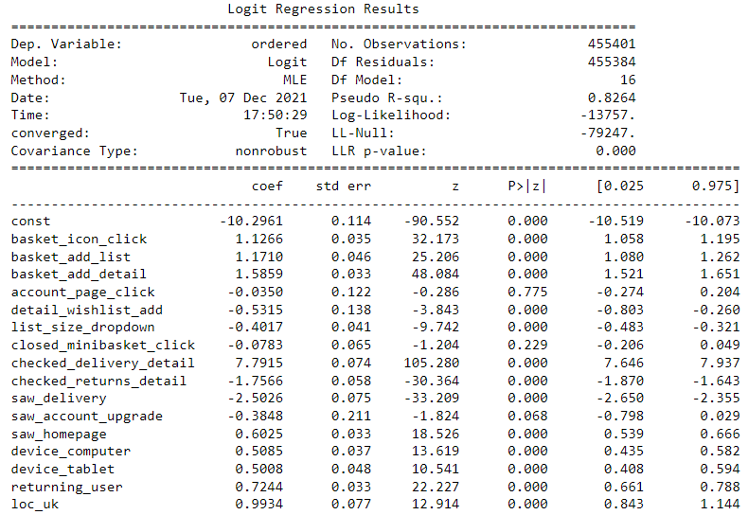
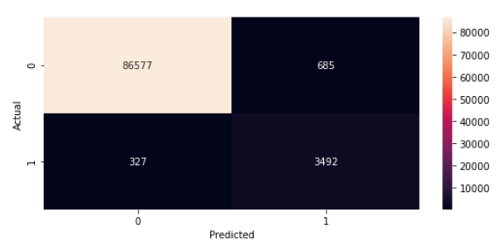
Identify Patterns in Data via Visualization, Statistical Analysis, & Data Mining
IST: 653: Marketing Analytics
Project Scope: Modeling website visitors’ propensity to purchase
Model 2: Re-ran Model 1 without the 4 variables with p-values over 0.05
R- squared = 82.64%
p- values: Three variables over 0.05 threshold
Recall Rate = 88.60%

Slide 12
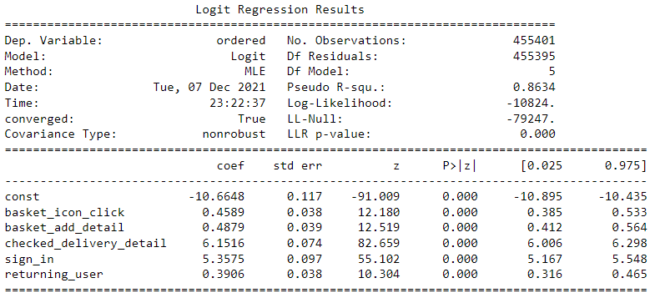
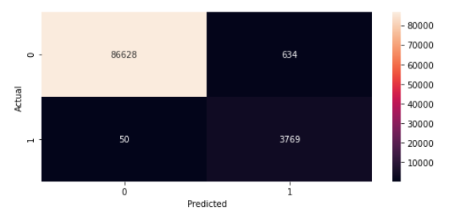
Identify Patterns in Data via Visualization, Statistical Analysis, & Data Mining
IST: 653: Marketing Analytics
Project Scope: Modeling website visitors’ propensity to purchase
Model 3: Used top 5 with highest correlation to Ordered
R- squared = 86.34%
p- values: All < 0.05
Recall Rate = 85.60%

Slide 13
Identify Patterns in Data via Visualization, Statistical Analysis, & Data Mining
IST: 653: Marketing Analytics
Project Scope: Modeling website visitors’ propensity to purchase
Reflection and learning outcome:
Course used excel but we found its limitations would not let us complete this analysis
Surprised that the third model resulted in the lowest recall rate
You need to learn to pivot and be understanding of unexpected results.

Slide 14
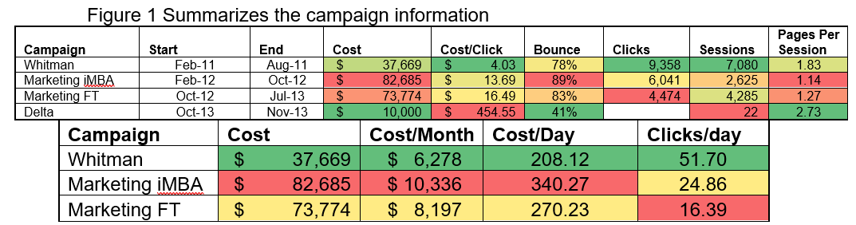
Develop alternative strategies based on the data
MBC 651: Business Analytics
Project Scope: Recruitment_Campaign
Project Goal:
Decide on a recruiting advertising campaign strategy for the Whitman School of Management
Analyze past campaigns to determine the best way to optimize future campaigns
Google Analytics supplied the data
Results:
Number of clicks has decreased
Cost per click increased

Slide 15
Develop alternative strategies based on the data
MBC 651: Business Analytics
Project Scope: Recruitment_Campaign
Projected Cost per Click by Year:
Assuming a linear relationship, the cost per click will reach $69.12 by 2020
Cost could be increasing due to popularity if Google Analytics

Slide 16
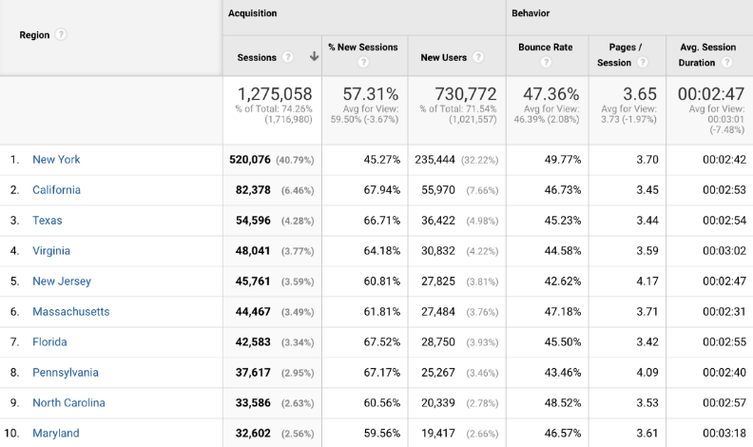
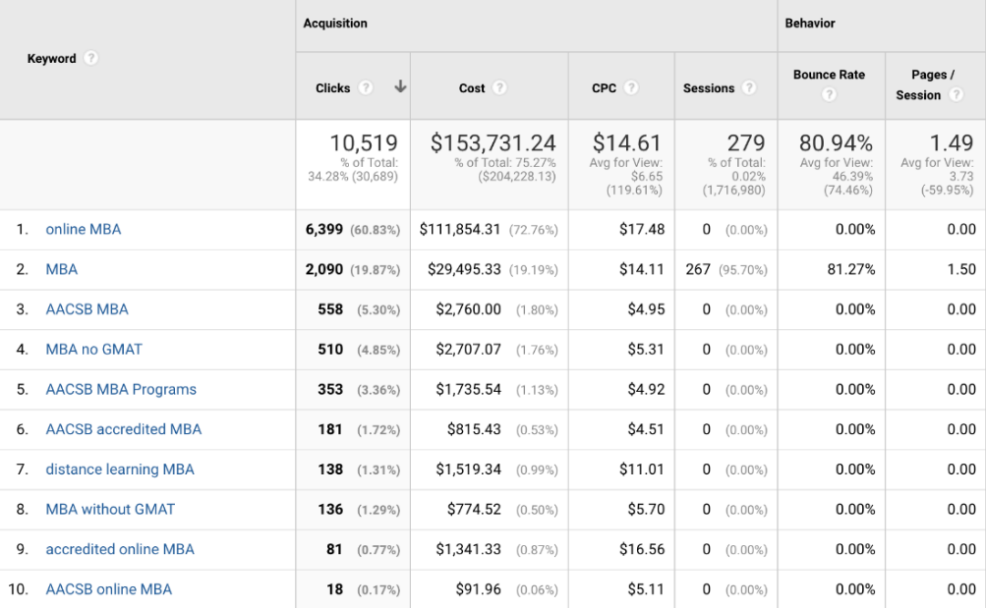
Develop alternative strategies based on the data
MBC 651: Business Analytics
Project Scope: Recruitment_Campaign
Let’s Understand the Audience Better:
Majority of searches came from New York; greater Syracuse, East Syracuse, Rochester, and Liverpool.
Fewer originated from larger California cities including Los Angeles, San Francisco, and San Diego as well as
Large cities including Boston, Washington, Atlanta, and Dallas had fewer searches as well
Key Words Used in the Searches:
Top keywords included “MBA,” “online MBA,” “AACSB MBA” and “MBA without GMAT.”
Almost all keywords contain a variation of “MBA,” “online,” “AACSB,” and “without GMAT.”
As a result, these represent the key reasons why Syracuse MBA are obtaining web traffic
Figure 1: Searches by State Figure 2: Top Key Word Used in Searches

Slide 17
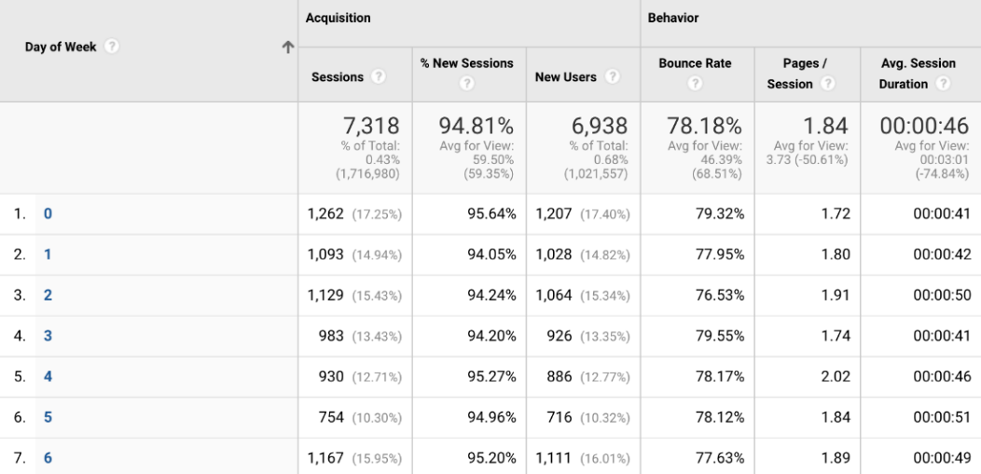
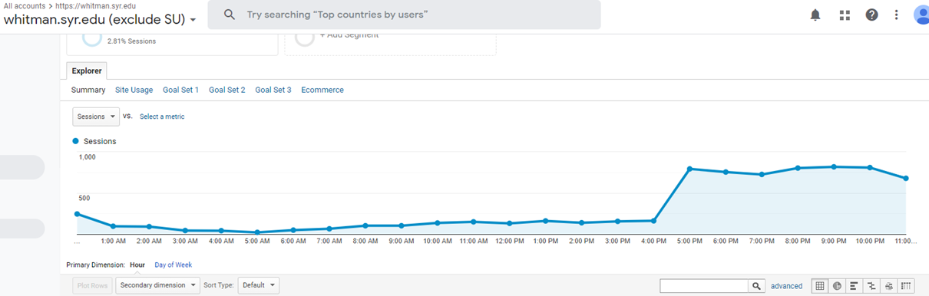
Develop alternative strategies based on the data
MBC 651: Business Analytics
Project Scope: Recruitment_Campaign
Best Day of the Week and Time of Day?:
Increase on weekends but relatively consistent
Increases around 4pm and stretching until 11pm.
Figure 3: Searches by Day of the Week Figure 4: Searches by Time of the Day

Slide 18
Develop alternative strategies based on the data
IST: 653: Marketing Analytics
Project Scope: Modeling website visitors’ propensity to purchase
Alternative Strategy:
Focus advertising around the greater New York area, near campus and south through New York City
The campaigns should utilize the top keywords words and the different combination of such words
Advertising should occur Saturdays through Monday from 4pm until 9pm to capture the highest likelihood of prospective searchers

Slide 19
Develop alternative strategies based on the data
Reflection and learning outcome – Recruitment Campaign:
It was beneficial to see how other analytic platforms function and represent data.
Google platform initiative and easy to navigate
Multiple ways to approach a problem. The ease at which the google platform was to use, shows how important it is to set up a dashboard so that the end customer can us it with ease. A product can have mounds of data available, but if is difficult to understand, it will not be used.

Slide 20
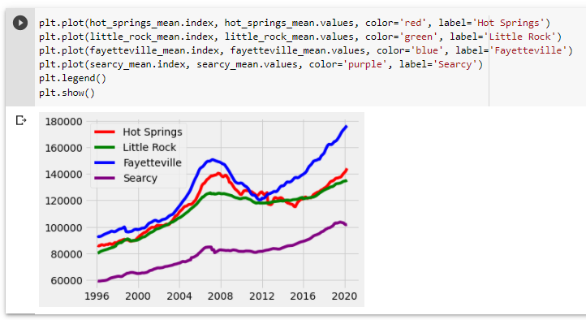
Develop a plan of action to implement the business decisions derived from the analyses
IST 718 – Big Data Analytics
Project Scope: Real Estate Investment Trust Investment
Project Goal:
Predict which ZIP codes provide the best investment for a Real Estate Investment Trust (REIT)
We looked at house price increases in four metro areas within Arkansas from 1996 to 2020.
Data Set:
Collected from the housing app Zillow showing single family residence by ZIP code
Csv file that contained over 30,000 rows and 300 columns of housing data from January 1996 to March 2020
Rows represented unique ZIPs and median house prices by month
Line Chart Showing House Price Increases from 1996 to 2020:

Slide 21
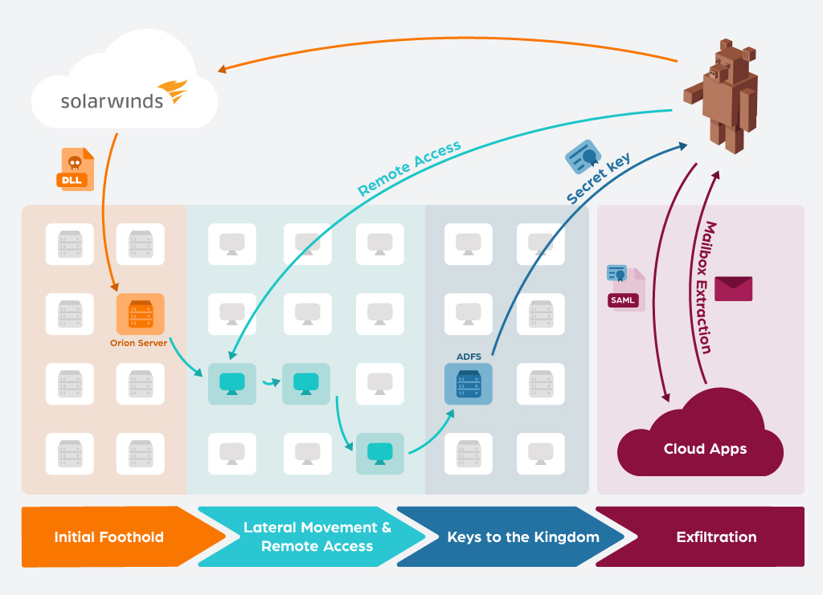
Develop a plan of action to implement the business decisions derived from the analyses
IST 623 – Information Security
Project Scope: Analyze SolarWinds Cyber Security Attack
Project Goal:
Researched the 2020 SolarWinds cyber security attack to determine the root cause
What plans can they implement to prevent future attacks?
Background:
In September 2019, cyber hacker group Nobelium, installed the malicious code, “Sunburst”, into a batch of software distributed by SolarWinds as an update
More than 30,000 public and private organizations -- including local, state and federal agencies -- use the SolarWinds network management system to manage their IT resources.
More than 18,000 SolarWinds customers installed the malicious updates.
Through this code, hackers accessed these customers’ information technology systems, which they could then use to install even more malware to spy on other companies and organizations.

Slide 22
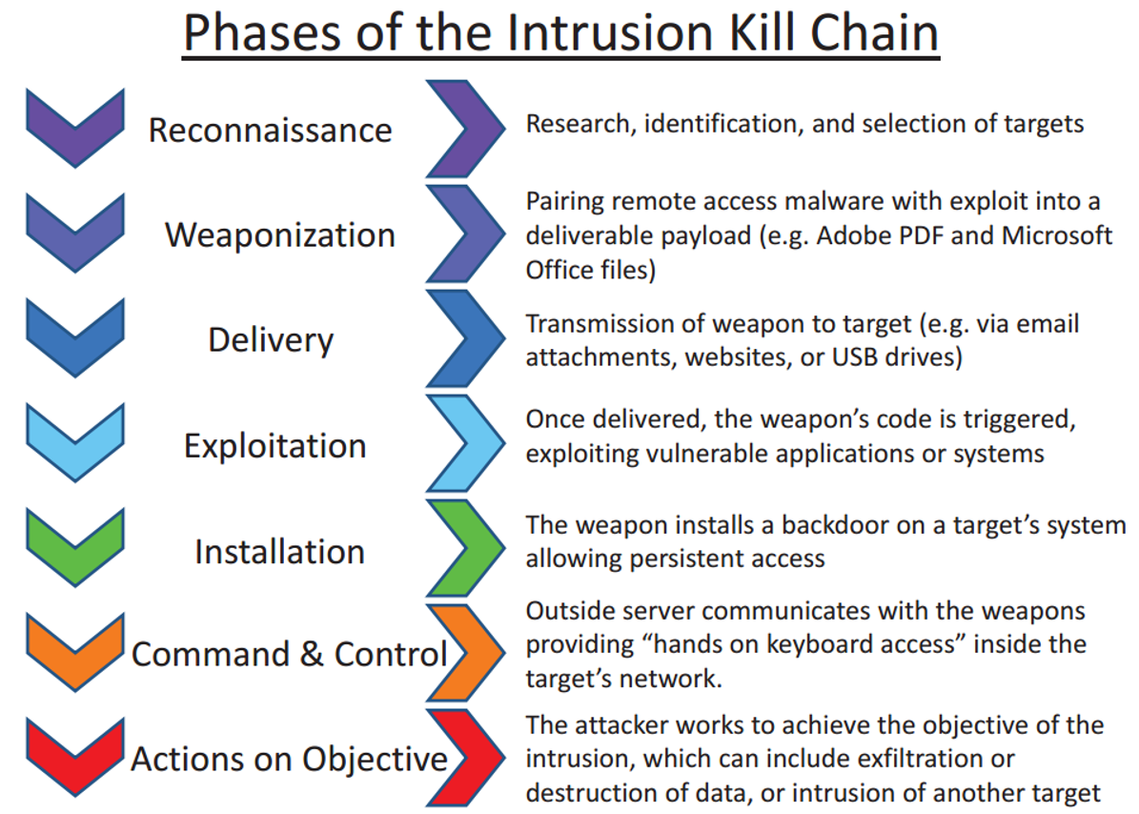
Develop a plan of action to implement the business decisions derived from the analyses
IST 623 – Information Security
Project Scope: Analyze SolarWinds Cyber Security Attack
Project Goal:
What plans can they implement to prevent future attacks?
Develop a Plan of Action!
Zero Trust Architecture- Only known and authenticated communication would have been allowed.
Limiting Access Rights - Many organizations give full access rights to suppliers because it’s easy. This is part of the reason the malware was able to cause such widespread issues, but the update software did not need full access rights. Had privileges been limited, damages would have been less
Cyber Kill Chain - A series of steps that trace stages of a cyberattack from the early reconnaissance stages to the exfiltration of data. It has defined how organizations map out their security controls but also determines how they measure their cyber resilience.

Slide 23
Develop a plan of action to implement the business decisions derived from the analyses
Reflection and learning outcome – REIT ZIP Code Investment:
The action plan is the culmination of the analysis.
At this point we have explained the data, the analysis goals, and the results
The idea here is that everything learned can be used to improve business operations by finding the best ZIP codes to invest money
While this is exciting it is also the scariest
To implement the changes, companies generally spend capital and are expecting a return on this investment.
Reflection and learning outcome – SolarWinds Cyber Security Attack:
Planning!
Do not believe you are immune from harm

Slide 24
Demonstrate communication skills regarding data and its analysis
IST 652: Scripting for Data Analytics
Project Scope: Analysis of the 2016 Rio de Janeiro Summer Olympic Games
For the Olympic games project, both a project write-up and presentation were required.
The presentation included a slide deck summarizing the key points of the analysis, results, and conclusion
IST 623 – Information Security
Project Scope: Analyze SolarWinds Cyber Security Attack
The SolarWinds project required a group presentation that was no more than 20 minutes long
Here, no write-up was required which was honestly harder.
This is because you needed to articulate to the professor and class solely by verbal communication.
This requires you, as a group, to find the most meaningful aspects of your research so you can clearly give the audience a clear picture of the project goals, analysis, results, and conclusion.

Slide 25
Synthesize the ethical dimensions of data science practice
Bias in Machine Learning:
Happens when the program results can be viewed as prejudice give the imputed assumptions
In the mortgage industry- typically credit reports are used to determine risk of default.
Is the Machine Learning code fair? What data sources are you using? Is the same type of data being collected? Does the algorithm use all the data, or do it pick and choose based on the company's policies?

Slide 26
Conclusion
Conclusion:
I believe that I have acquired all the capabilities and learning outcome set forth by the ADS program.
I plan to bring this to my current employer
Most important, I will strive to continue learning

